Slide 1


Tabular Data Analysis
2025. 12. 12.
JangHoon Chun
Department of Medical Device Industry,
Gangnam Severance Hospital,
Yonsei University College of Medicine

Slide 2
1. What’s discussed in the last meetings
Reported results from multiple machine learning models
Needs to understand data characteristics and to explore details of machine learning models
Needs to run machine learning models in various ways: stratification, fine-tuning parameters

Slide 3
2. Research Summary
Postmenopausal cohort extracted. (clinical, medication, and mammography-derived features)
Logistic Regression baseline evaluated via hold-out and 5-fold CV.
Grid Search exposed Precision-Recall imbalance → need for threshold and sampling refinement
External datasets (Diabetes, PCOS) achieved AUC 0.96-0.98 → strong generalizability

Slide 4
3. Detailed progress
인체 임상 변수
약물 복용 변수
Variable | Description | Units / Classification
File Analyzed | 환자 / 케이스 식별자 | ID
Osteoporosis | 골다공증 여부 (0=정상, 1=골다공증) | Binary
Age | 나이 | 세
진료년월일 | 검사 날짜 | YYYY-MM-DD
키 | 키 | cm
체중 | 몸무게 | Kg
BMI | 체질량지수 | kg/m²
허리둘레 | 허리 둘레 | cm
근육량SoftLeanMass | 부위별 평균 근육량 | kg
체지방율BodyFat | 체지방 비율 | %
체지방량FatMassKg | 체지방 총량 | kg
복부지방율WHRatio | 복부지방률 (WH Ratio) | %
복부내장지방량 | 내장지방량 | kg
복부피하지방량 | 피하지방량 | kg
초경연령ALL | 초경 시작 나이 | 세
폐경여부 | 폐경 여부 (1=예, 0=아니오) | Binary
출산횟수ALL | 출산 횟수 | Count
Variable | Units / Classification
혈압약 | no: 0 / yes: 1
당뇨약 | no: 0 / yes: 1
고지혈증약 | no: 0 / yes: 1
흡연 | no: 0 / current: 1 / exsmoke: 2
운동 | no: 0 / yes: 1
음주 | no: 0 / yes: 1
유방암 가족력 이력 | no: 0 / yes: 1

Slide 5
3. Detailed progress
영상 파생 변수
Mammography로부터 계산된 값
Variable | Description | Units / Classification
Average breast area | 유방 전체 면적 평균 | cm²
Average dense area | 치밀 조직 면적 평균 | cm²
Average breast density | 유방 내 치밀조직 비율 | %
Breast density grading | 유방 밀도 등급 | 1~4 단계
*BIRADS Category | BI-RADS 평가 카테고리 | 1~5 등급
*BIRADS (Breast Imaging Reporting and Data System)

Slide 6
3. Detailed progress
환자 데이터
전체 8,768명 중 폐경 환자군만 고려
<폐경 환자군 내 정상/골다공증 비율>
Group | Samples
Total | 3,961(100)
Normal | 3,475(87.7)
Osteoporosis | 486(12.3)

Slide 7
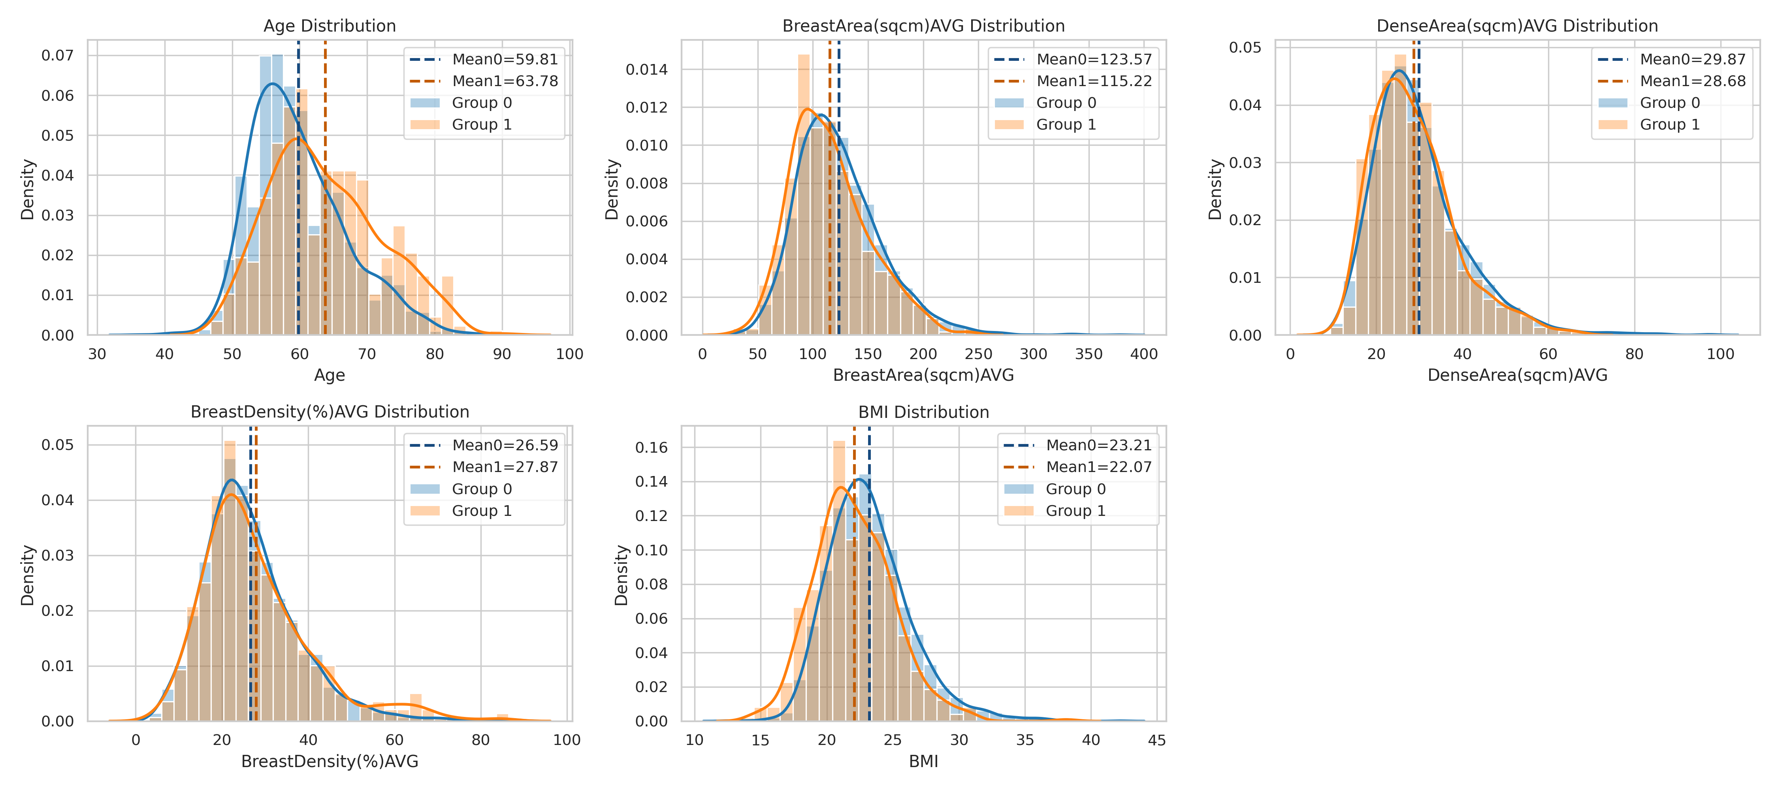
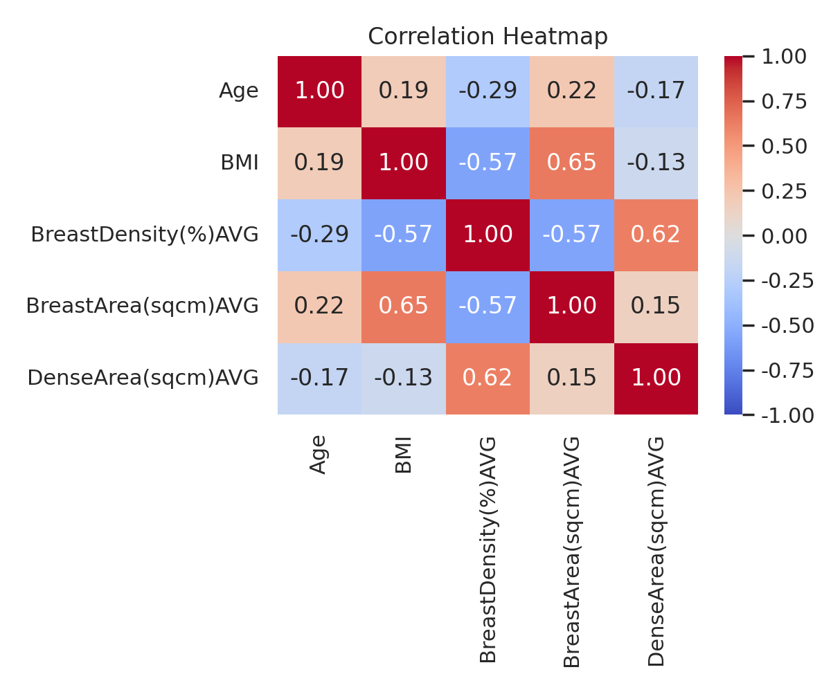
3. Detailed progress
주요 변수별 정상/골다공증 분포 비교

Slide 8
3. Detailed progress
주요 변수별 정상/골다공증 분포 비교
Performed t-test
Type | Age | BMI | BreastDensity(%)AVG | BreastArea(sqcm)AVG | DenseArea(sqcm)AVG
t-stat | -10.18 | 7.86 | -2.09 | 4.84 | 2.53
p-value | <0.001 | <0.001 | 0.037 | <0.001 | 0.012
Variable | Classification | N_Sample | mean | std
Age | Total | 3,961 | 60.3 | 7.34
 | Normal(0) | 3,475 | 59.81 | 7.07
 | Osteoporosis(1) | 486 | 63.78 | 8.18
BMI | Total | 3,961 | 23.07 | 3.12
 | Normal(0) | 3,475 | 23.21 | 3.12
 | Osteoporosis(1) | 486 | 22.07 | 2.99
BreastDensity(%)AVG | Total | 3,961 | 26.75 | 11.45
 | Normal(0) | 3,475 | 26.59 | 11.24
 | Osteoporosis(1) | 486 | 27.87 | 12.81
BreastArea(sqcm)AVG | Total | 3,961 | 122.54 | 38.10
 | Normal(0) | 3,475 | 123.57 | 38.38
 | Osteoporosis(1) | 486 | 115.22 | 35.22
DenseArea(sqcm)AVG | Total | 3,961 | 29.73 | 10.59
 | Normal(0) | 3,475 | 29.87 | 10.71
 | Osteoporosis(1) | 486 | 28.68 | 9.58

Slide 9
3. Detailed progress
Osteoporosis Diagnosis
Machine learning models were generated using logistic regression.
Two validation approaches: hold-out (8:2), 5-fold cross validation (CV)
Grid search was tested: C, penalty, solver, class_weight
Input: Age, BMI, average breast density
Output: Osteoporosis
Feature Set | Accuracy | Precision | Recall | F1 | AUC
HoldOut (fixed params) | .6608 | .2171 | .6804 | .3292 | .7146
5-fold CV (fixed params) | .6608 | .2171 | .6804 | .3292 | .7146
HoldOut (GridSearch) | .8789 | 1.0 | .0103 | .0204 | .7118
5-fold CV (GridSearch) | .8777 |  |  |  | .7148

Slide 10
3. Detailed progress
Osteoporosis Diagnosis
Machine learning models were generated using logistic regression.
Two validation approaches: hold-out (8:2), 5-fold cross validation (CV)
Grid search was tested: C, penalty, solver, class_weight
Input: Age, BMI, average breast density, average breast area, average dense area
Output: Osteoporosis
In the case of binary classification, the recall of weighted avg is the same as accuracy
hold-out
5-fold cv
Type | Accuracy | Precision | Recall | F1
macro avg | .878 | .689 | .504 | .477
weighted avg | .878 | .832 | .878 | .823
Type | Accuracy | Precision | Recall | F1
macro avg | .877 | .666 | .505 | .480
weighted avg | .877 | .826 | .877 | .823
hold-out (grid search)
5-fold cv (grid search)
Type | Accuracy | Precision | Recall | F1
macro avg | .658 | .576 | .668 | .549
weighted avg | .658 | .848 | .658 | .717
Type | Accuracy | Precision | Recall | F1
macro avg | .658 | .576 | .668 | .549
weighted avg | .658 | .848 | .658 | .717

Slide 11
3. Detailed progress
Osteoporosis Diagnosis
Machine learning models were generated using logistic regression.
Two validation approaches: hold-out (8:2), 5-fold cross validation (CV)
Grid search was tested: C, penalty, solver, class_weight
Input: All of Features
Output: Osteoporosis
hold-out
5-fold cv
Type | Accuracy | Precision | Recall | F1
macro avg | .875 | .649 | .521 | .512
weighted avg | .875 | .825 | .875 | .830
Type | Accuracy | Precision | Recall | F1
macro avg | .876 | .671 | .519 | .509
weighted avg | .876 | .830 | .876 | .829
hold-out (grid search)
5-fold cv (grid search)
Type | Accuracy | Precision | Recall | F1
macro avg | .677 | .586 | .687 | .566
weighted avg | .677 | .855 | .677 | .732
Type | Accuracy | Precision | Recall | F1
macro avg | .672 | .579 | .671 | .558
weighted avg | .672 | .849 | .672 | .728

Slide 12
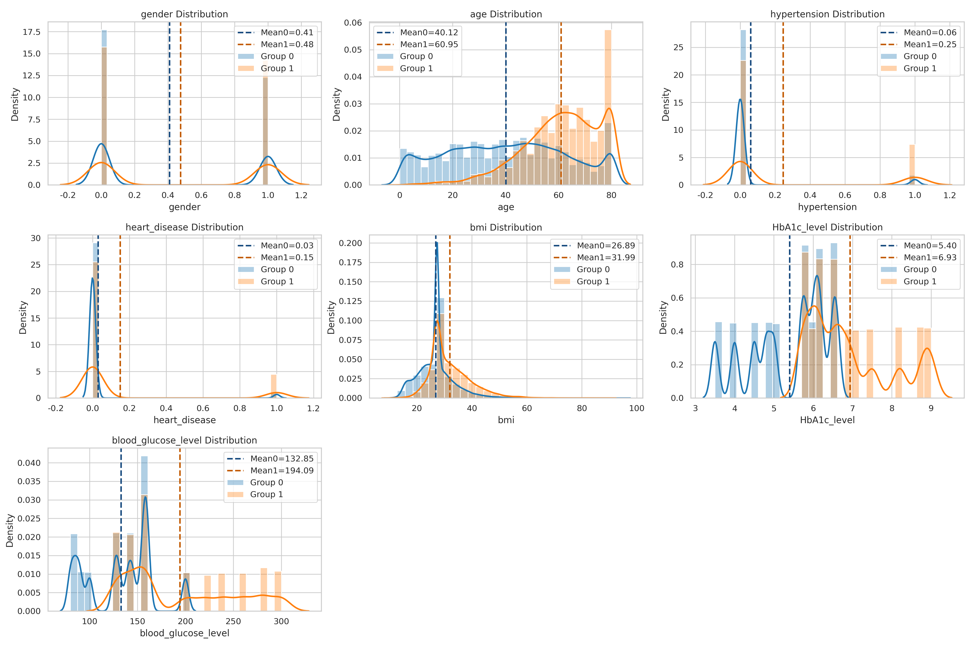
3. Detailed progress
Diabetes Diagnosis Dataset
Input: gender, age, bmi, HbA1c_level, blood_glucose_level
Output: Diabetes_Diagnosis

Slide 13
3. Detailed progress
Diabetes Diagnosis Dataset
Input: gender, age, bmi, HbA1c_level, blood_glucose_level
Output: Diabetes_Diagnosis
Other People’s Result
Feature Set | Accuracy | Precision | Recall | F1 | AUC
HoldOut (fixed params) | .8814 | .4090 | .8882 | .5601 | .9608
5-fold CV (fixed params) | .8814 | .4090 | .8882 | .5601 | .9608
HoldOut (GridSearch) | .9149 | .4998 | .8335 | .6249 | .9608
5-fold CV (GridSearch) | .9149 | .4998 | .8335 | .6249 | .9608
Type | Accuracy | Precision | Recall | F1
macro avg | .949 | .83 | .88 | .85
weighted avg | .949 | .95 | .95 | .95

Slide 14
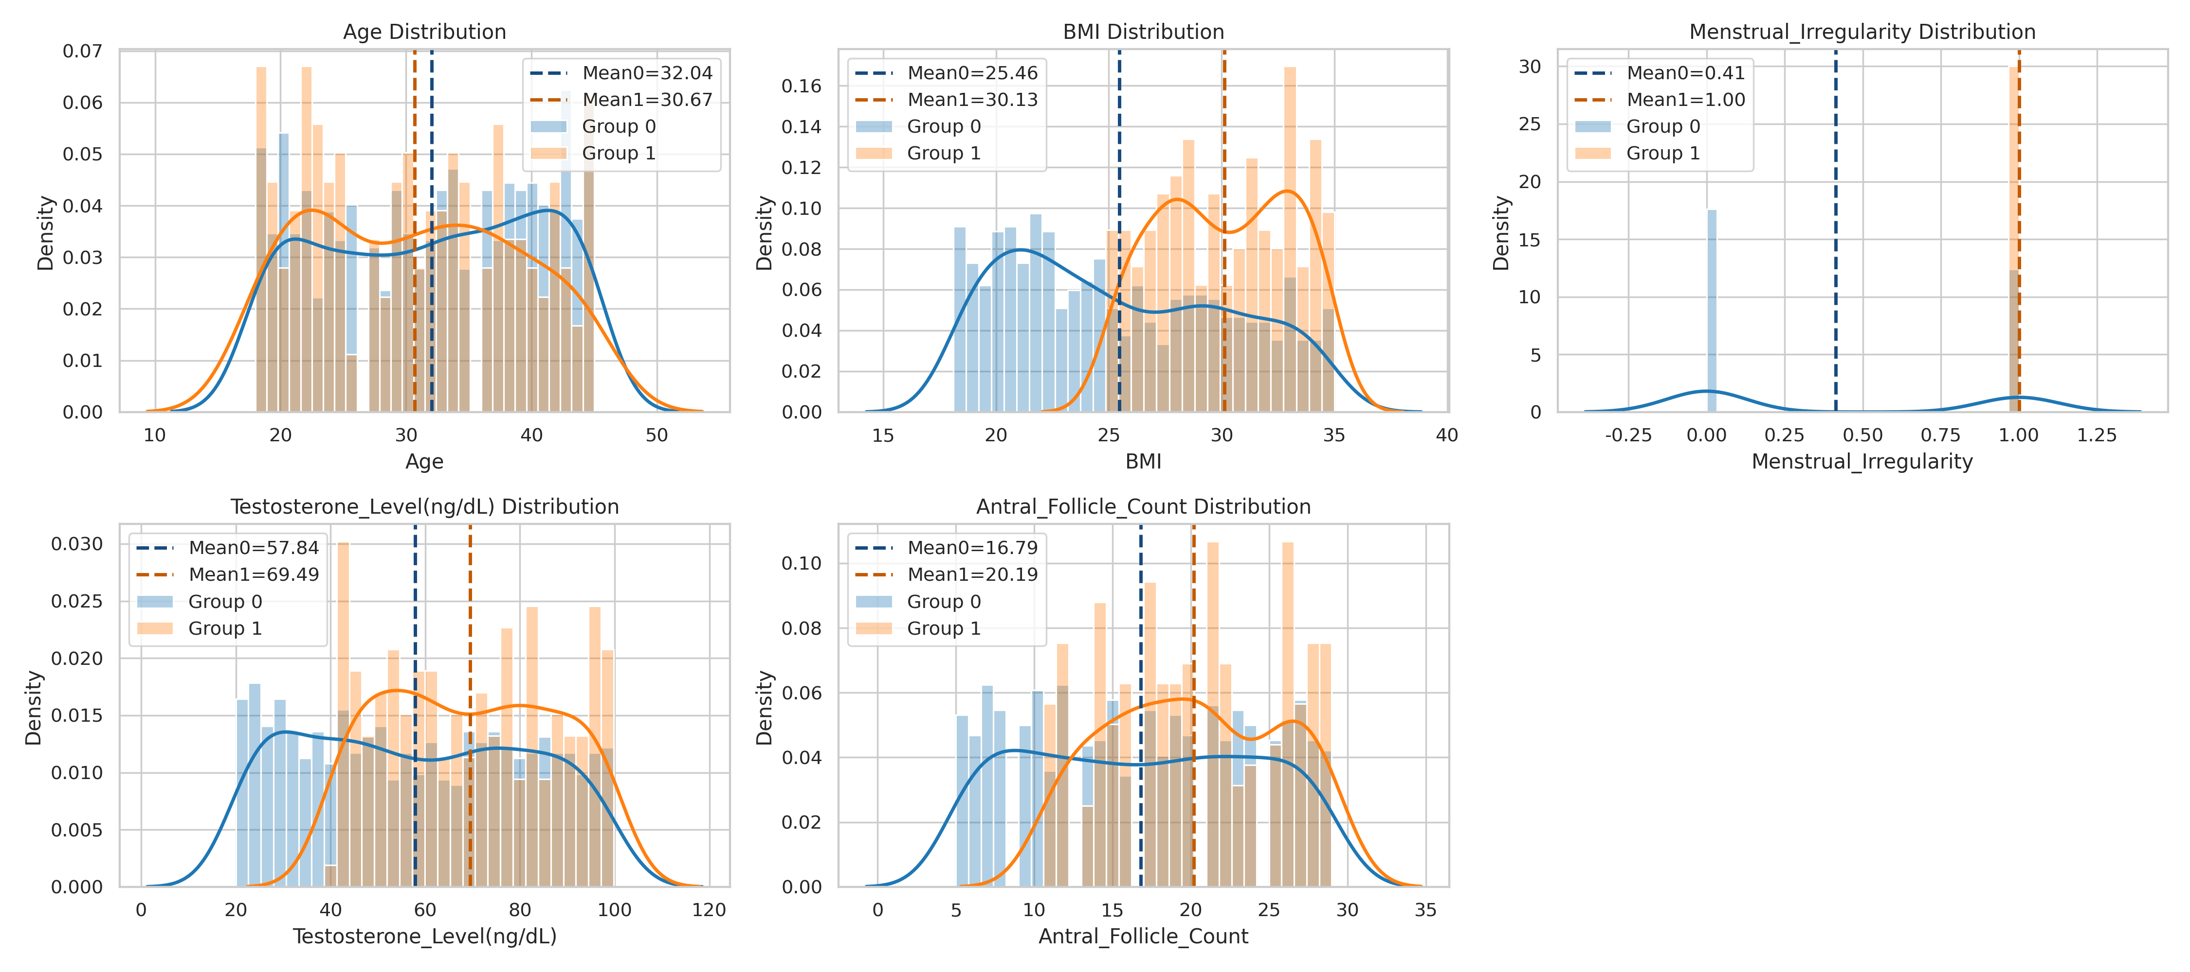
3. Detailed progress
PCOS Diagnosis Dataset
Input: Age, BMI, Menstrual_Irregularity, Testosterone_Level(ng/dL), Antral_Follicle_Count
Output: PCOS_Diagnosis

Slide 15
3. Detailed progress
PCOS Diagnosis Dataset
Input: Age, BMI, Menstrual_Irregularity, Testosterone_Level(ng/dL), Antral_Follicle_Count
Output: PCOS_Diagnosis
Feature Set | Accuracy | Precision | Recall | F1 | AUC
HoldOut (fixed params) | .8800 | .6250 | 1.0 | .7692 | .9752
5-fold CV (fixed params) | .8800 | .6250 | 1.0 | .7692 | .9752
HoldOut (GridSearch) | .9150 | .7170 | .9500 | .8172 | .9777
5-fold CV (GridSearch) | .9150 | .7170 | .9500 | .8172 | .9777

Slide 16
3. Detailed progress
PCOS Diagnosis Dataset
Other People’s Result
Logistic Regression
KNN
Type | Accuracy | Precision | Recall | F1
macro avg | .89 | .82 | .80 | .81
weighted avg | .89 | .88 | .89 | .88
Type | Accuracy | Precision | Recall | F1
macro avg | .96 | .95 | .94 | .94
weighted avg | .96 | .96 | .96 | .96
Naive Bayes
Decision Tree
Type | Accuracy | Precision | Recall | F1
macro avg | .69 | .70 | .81 | .66
weighted avg | .69 | .88 | .69 | .73
Type | Accuracy | Precision | Recall | F1
macro avg | .99 | 1.0 | .99 | .99
weighted avg | .99 | 1.0 | .99 | .99

Slide 17
4. Next Plans
SMOTE 이외의 다른 Augmentation 기법 적용

Slide 18


